Slide 1
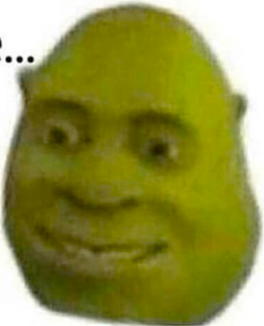
ChildSafeAI
Idk dude,
that was
kinda
offensive…
By Bunalip, framacha, Flomo11

Slide 2
The Internet Isn’t Child-Safe by Default
limited Parental controls
Filters don’t cover dynamic or embedded content like SVGs or JavaScript-rendered text.

Slide 3
mitmproxy- intercept HTTP(S) traffic.
Filters HTML, JavaScript, forms, and URLs.
Replaces offensive terms
censors SVGs and DOM mutations.

Slide 4
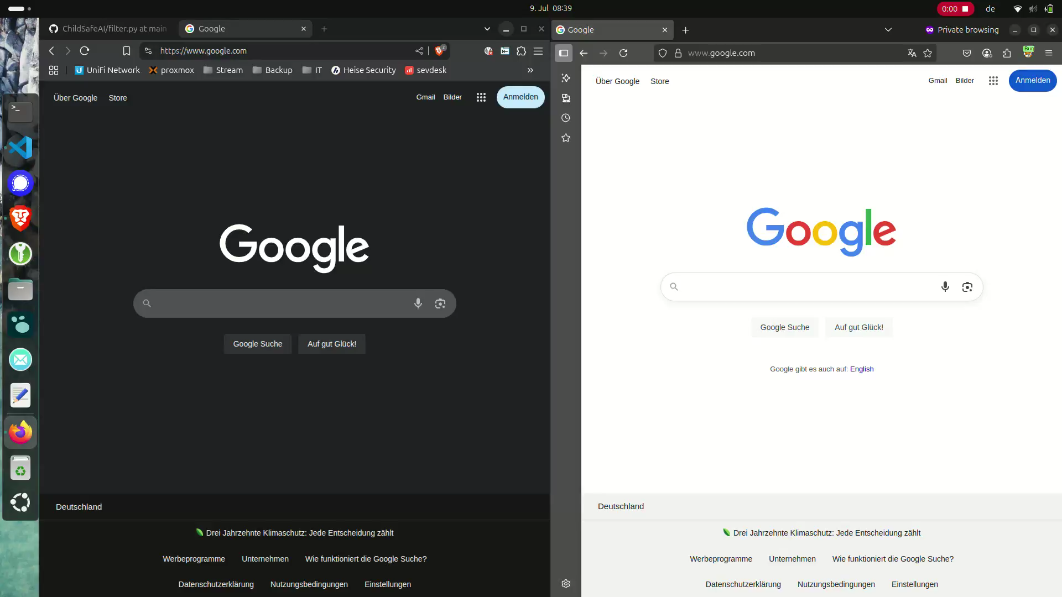
Our Prototype- Smart filtering with JS+ Python
Python: URL & form filtering
JS: Blur text, block SVGs
Dynamic DOM support
Easy proxy setup

Slide 5
What’s next
Browser extension
Keyword list UI
AI content detection
Multilingual support
One-click install

